Slide 1
Adapter Design Pattern
Presented by –
Rathod Krutarth(240160510040)
Senghani Riya(240160510045)

Slide 2
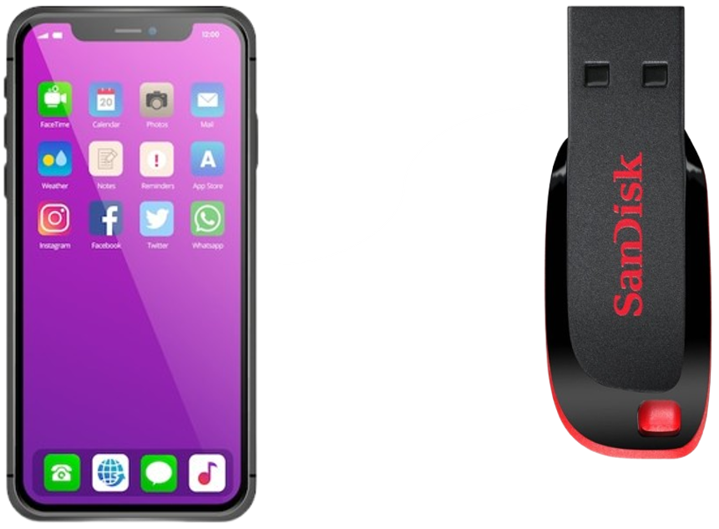
Problem
You have a mobile phone that you want to connect to a pendrive, but they have incompatible interfaces. The mobile phone has a USB-C or Micro-USB port, while the pendrive has a USB-A connector. Directly connecting them is not possible.

Slide 3
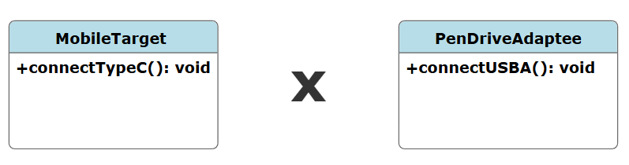
Problem
You have a mobile phone that you want to connect to a pendrive, but they have incompatible interfaces. The mobile phone has a USB-C or Micro-USB port, while the pendrive has a USB-A connector. Directly connecting them is not possible.

Slide 4
Problem
Code Incompatibility: The Main class cannot directly use XMLSoftware in place of JSONData.
Code Duplication: You may need to rewrite or duplicate logic to convert XML to JSON in multiple places.
Tight Coupling: Without an adapter, you're forced to tightly couple the client to specific data formats.
Reduced Flexibility and Reusability: You can’t plug in new data formats (like XML) into a system that only understands JSON without modifying existing code.
Violation of Open/Closed Principle: You’d need to modify existing classes (e.g., Main or JSONSoftware) instead of extending them.

Slide 5
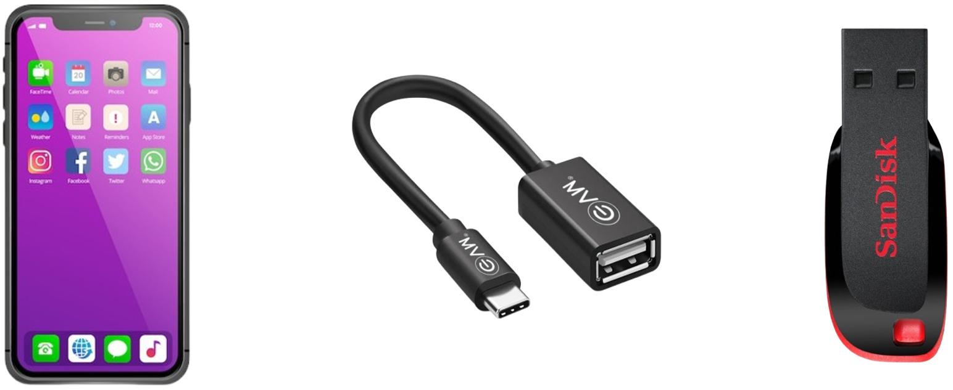
Solution
The OTG (On-The-Go) adapter serves as the adapter, enabling the mobile phone to connect to the pendrive by converting the USB-C or Micro-USB port to a USB-A port, making them compatible.

Slide 6
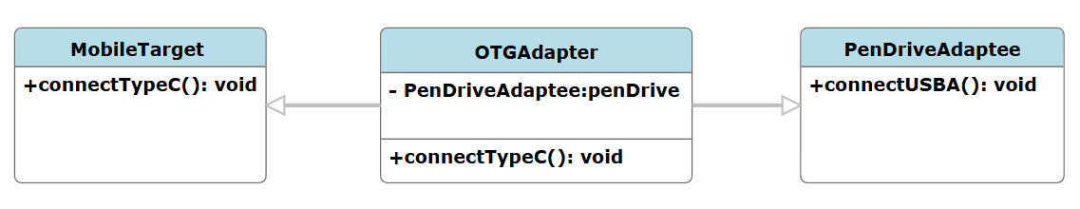
Solution
The OTG (On-The-Go) adapter serves as the adapter, enabling the mobile phone to connect to the pendrive by converting the USB-C or Micro-USB port to a USB-A port, making them compatible.

Slide 7
Adapter Design Pattern
The Adapter design pattern is a structural pattern.
It allows incompatible interfaces to work together by converting the interface of one class (the "adaptee") into another interface that clients expect (the "target").
It essentially acts as a bridge, enabling classes with different interfaces to collaborate.

Slide 8
Why the Adapter Design Pattern a Structural Pattern?
The Adapter Design Pattern is a structural pattern because it focuses on the structure of the system by connecting two incompatible interfaces without modifying their existing code.
Key Reasons:
Connects Different Structures
Does Not Change Original Classes
Follows Open/Closed Principle

Slide 9
Intent
Adapter is a structural design pattern that allows objects with incompatible interfaces to collaborate.
Motivation
Imagine an old application that exchanges data using XML format, but a new application is designed to use JSON because it is lightweight and easier to parse. Direct communication between these systems is not possible due to their differing data formats. Instead of modifying the old application, which could be complex and risky, an Adapter can be introduced. This Adapter acts as a bridge, converting XML requests into JSON format and vice versa, allowing seamless communication between the two systems without altering their core implementations.

Slide 10
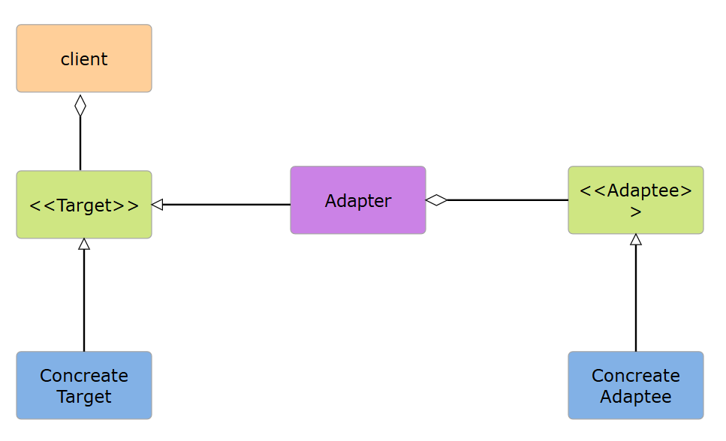
Structure Diagram

Slide 11
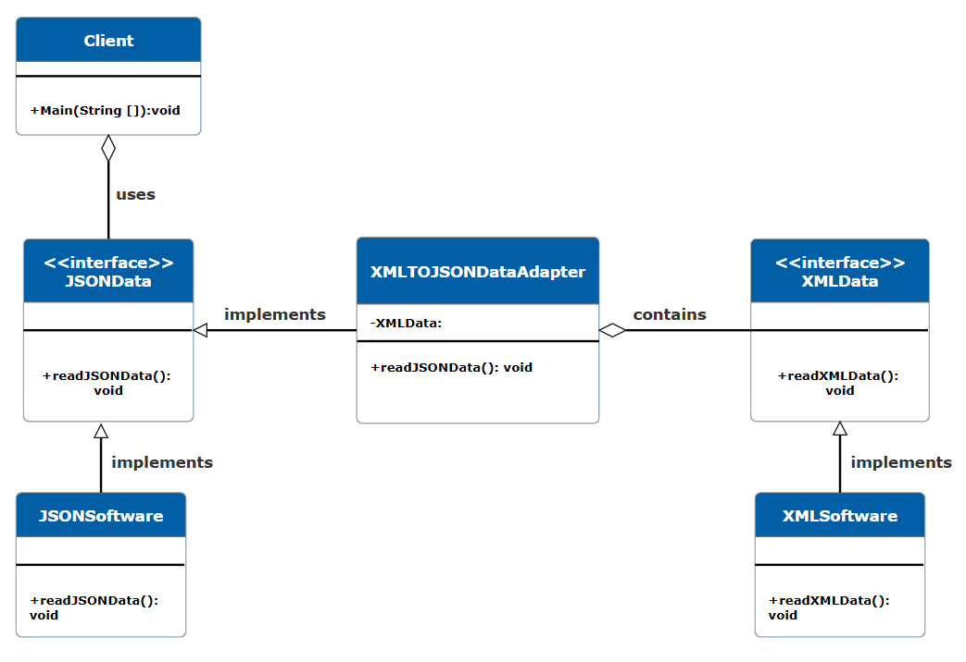
Class Diagram

Slide 12
Participants and Their Role
Participant | Class/Interface in Example | Role
Target | JSONData (Interface) | The interface sought by the client. It defines readJSONData() , which the client expects to use.
Concrete Target | JSONSoftware (Class) | A normal implementation of JSONData that directly processes JSON data.
Adaptee | XMLData (Interface) | The existing, incompatible interface that defines readXMLData().
Concrete Adaptee | XMLSoftware (Class) | The actual class that implements XMLData, providing XML-specific functionality.
Adapter | XMLTOJSONDataAdapter (Class) | Bridges the gap between XMLData (Adaptee) and JSONData (Target). It implements JSONData and internally uses XMLData.
Client | Main (Class) | Uses JSONData but interacts with XMLSoftware via the adapter, without directly using XMLData.

Slide 13
How to Implement
Identify Incompatibility: Have a service class with an incompatible interface that the client cannot use directly.
Define Client Interface: Create an interface that represents how the client expects to interact with the service.
Create Adapter Class: Implement the client interface in an adapter class, initially leaving methods unimplemented.
Store Service Reference: Add a field in the adapter to hold a reference to the service class, typically set via the constructor.
Implement Adaptation Logic: In the adapter, translate client interface calls into equivalent service calls, handling data or interface conversion as needed.
Client Uses Adapter: The client interacts only with the adapter via the client interface, ensuring flexibility and decoupling from the actual service class.

Slide 14
Collaboration
Client calls Adapter using Target Interface.
Adapter class translates this request and delegates it to adaptee using one/multiple method calls using Adaptee Interface.
Adaptee returns response to Adapter class as defined in Adaptee Interface and then Adapter transforms this response before returning it to Client as defined in Target Interface.
Also Known As
Wrapper (since it wraps one interface and makes it compatible with another).

Slide 15
Advantages
Allows reuse of existing code with different interfaces.
Improves code flexibility by enabling communication between incompatible components.
Supports open/closed principle (allows adding new adapters without modifying existing code).
Disadvantages
Introduces extra layers of abstraction, which can make debugging harder.
If overused, it might lead to unnecessary complexity in the code structure.

Slide 16
Applicability
Use the Adapter class when you want to use some existing class, but its interface isn’t compatible with the rest of your code.
When a new system wants to interact with legacy(old) system using new interface which is not compatible with interface of legacy system.
When you want to use a 3rd party framework or library whose interface is incompatible with your system.
When to not use it
You can modify the original code to match the required interface. Instead of adding an adapter, refactoring might be a cleaner solution.
A simple method override or extension is enough. If you can just extend a class and override a method to achieve the same result, an adapter is overkill.

Slide 17
Related Patterns
Facade Pattern (Provides a simplified interface, often using adapters internally).
Decorator Pattern (adds behavior dynamically without modifying the object).
Proxy Pattern (controls access to another object).
Design Principle
Single Responsibility Principle (SRP): The Adapter class has one responsibility: adapting the interface.
Open/Closed Principle (OCP): The Adapter pattern allows you to extend functionality by adding new adapters without modifying existing code.

Slide 18
Important Points About Adapter Pattern
Adapter class changes the interface of an existing object.
Adapter class is a good example of object composition. Adapter class "has a" instance of the adaptee class.
We can use an Adapter with any class Implementing Adaptee Interface.
Adapter wraps an object to change it's interface whereas a decorator wraps an object to add extra functionalities.

Slide 19
Real-Time Use
Java InputStreamReader & OutputStreamWriter: Converts byte streams to character streams.
The InputStream class works with byte streams, but sometimes we need to work with character streams. Java provides InputStreamReader, which acts as an adapter that converts an InputStream (bytes) into a Reader (characters).
JDBC Drivers: Adapt different database protocols to the common JDBC interface.
Java provides a common interface (java.sql.Connection) for connecting to databases. Different databases (MySQL, PostgreSQL, etc.) have their own incompatible implementations. To make them work with the JDBC API, database vendors provide JDBC Drivers as Adapters.
Convert Array to List in Java
If you just need a read-only list, use Arrays.asList().
If you need a modifiable list, use new ArrayList<>(Arrays.asList()).

Slide 20
THANK YOU

